Slide 1
DXing from a City Lot
Gary L. Drasch
K9DJT

Slide 2
What is DXing and Why???
Wikipedia: Amateur radio operators who specialize in making two way radio contact with other amateurs in distant countries are referred to as "DXers".
It’s a challenge! Not only is propagation required, there is a technique or skill involved. In addition an operator needs the ability to assemble a station which is capable of performing.

Slide 3
My DXing History
Countries Worked since December 1, 2010

Slide 4
How do I reach the next plateau?
At this stage of the game I had already:
upgraded to a dual receiver radio (FT-2000)
bought and refurbished an amplifier (Desperado)
Had a 40 foot tower with a tri-band beam.
Had a trap dipole for 40, 80 and 160 meters.
The answer was the antenna system, but what more could I do on a city lot 120 feet wide and 90 feet deep?
---And the wife doesn’t want to move to the country!!!

Slide 5
But my Antenna System is working…
I was reminded of something I already knew while attending the W9DXCC convention in Chicago this year, and that was…
All antennas work!
They don’t need to be resonant…
They don’t need to be certain height…
They don’t necessarily need to be any particular shape…
All you need is a good antenna tuner which will create a conjugate match, and they’ll work!

Slide 6
Efficiency is the difference!
How efficiently is the system actually working?
How much loss is created by SWR?
How much loss is caused by the tuner itself?
Will a resonant antenna work better?
Should it be a vertical or dipole in nature?
It is not just the antenna, transmission line or tuner…
It is the antenna SYSTEM as a whole!
Just ask the Curmudge!

Slide 7
System Evaluation by Band:
10, 15 and 20 meters: KT-34A 4-ele beam, excellent performance, old RG-8U solid dielectric coax. Element-to-boom connectors need replacement.
12/17 meters: No specific antenna. Have been matching tri-bander with mediocre results.
30 meters: No antenna
40, 80 and 160 meters: Trap dipole which works as expected. Narrow bandwidth and more of a cloud warmer than a DX antenna.

Slide 8
Project Decision by Band
10, 15 and 20 meters: Lower KT-34A and replace element-to-boom connectors. Replace RG-8U coax with 7/8” hardline.
12/17 meters: Construct my own elements based on the Cushcraft A3WS, and attach to bottom of KT-34A boom. Share the 7/8” hardline with KT-34A and the below.
30/40 meters: Construct half-Slopers using the tower and burying a radial system into the lawn. Share 7/8” hardline with beam.
The 7/8” hardline will be switched via a mechanical rotary switch utilizing “N” connectors

Slide 9
Project Decision by Band (Continued)
80 meters: Construct an Inverted-L utilizing the in-ground radial system and an additional shared 7/8” hardline.
160 meters: Construct a Gamma Matched inverted-L utilizing the tower and the in-ground radial system. It will share the 7/8” hardline mentioned above.
Antennas will be matched and switched to the 7/8” at the base of the tower.

Slide 10
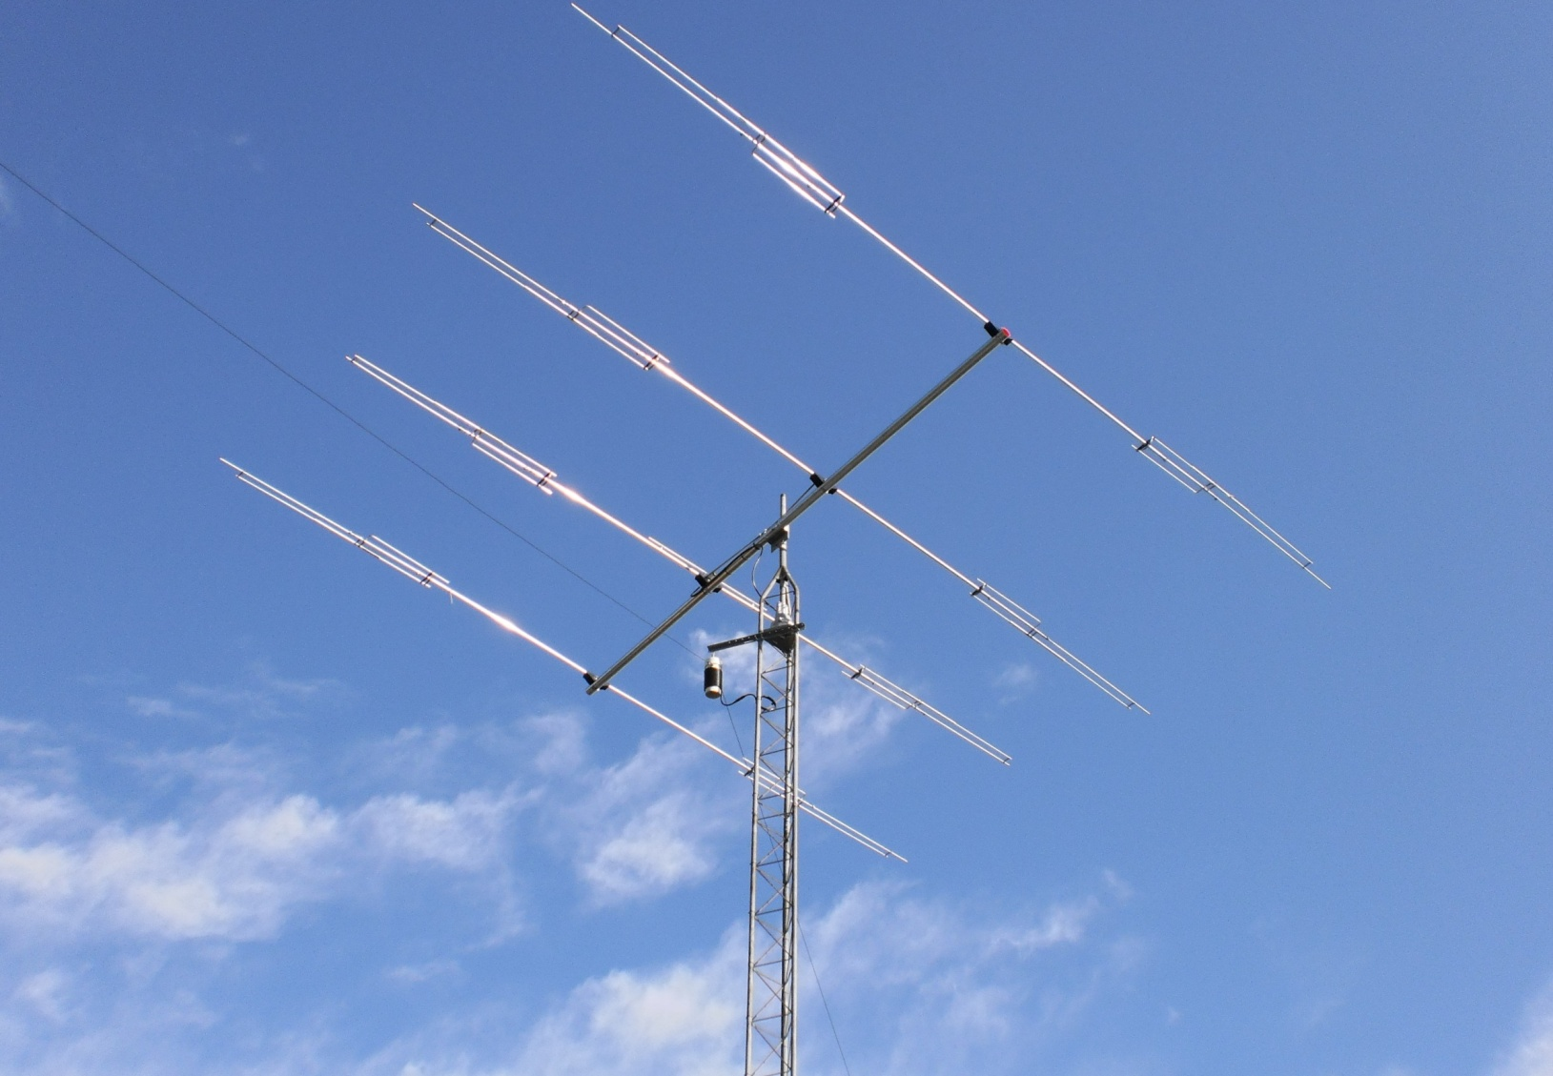
My Starting Point
KLM KT-34A
Ugly Balun –
Feeding 40, 80 & 160
trap dipole
Tapered Tower Top

Slide 11
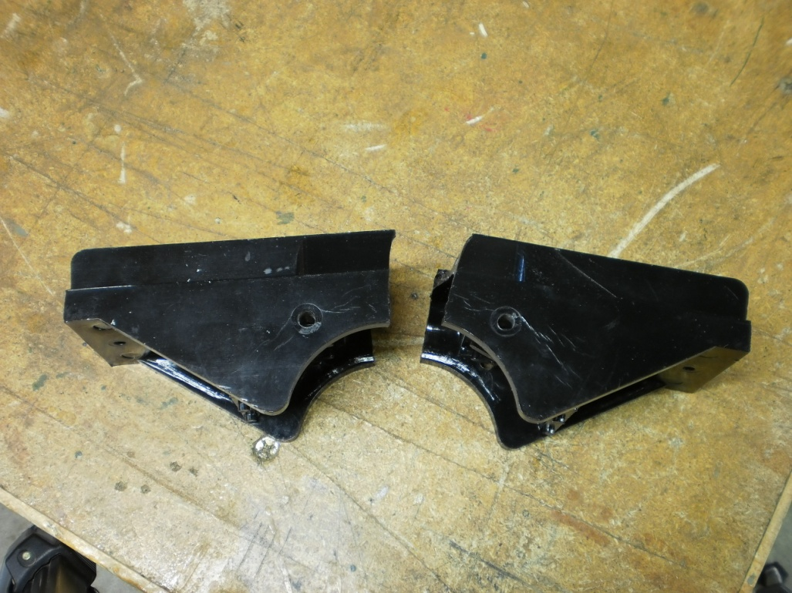
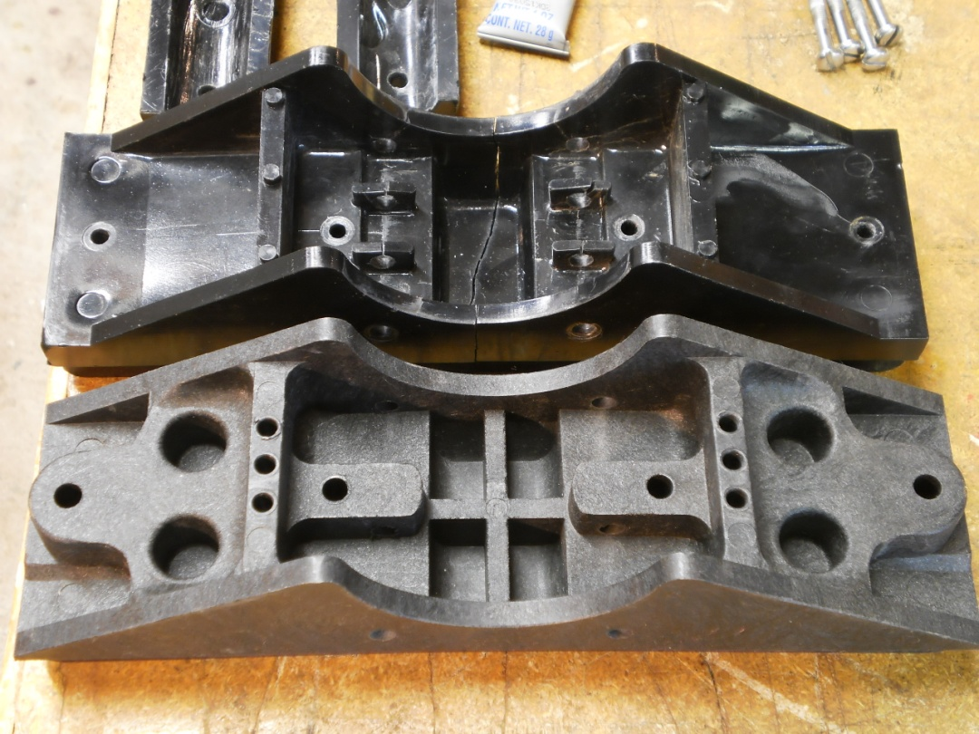
Off the Air…
Flat Top-plate
Removal of tri-bander and tower modifications
Customized straight section
7/8” Hardline
Element-Boom Connectors
Preventative Maintenance

Slide 12
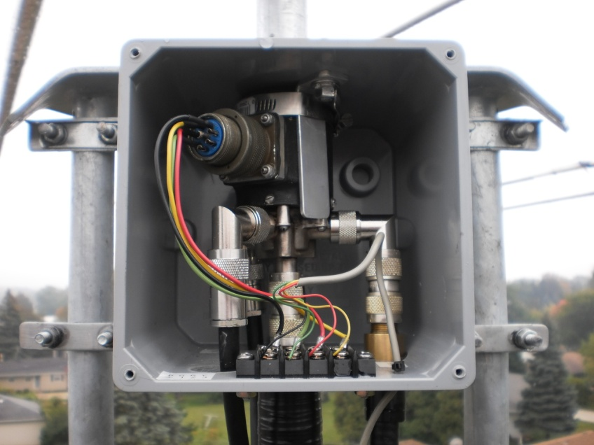
Rotor and Switch Installation…
6x6x6 Electrical
Enclosure
Modified Rotor Plate
Half-Sloper interface and bead-choke
½” Hardline

Slide 13
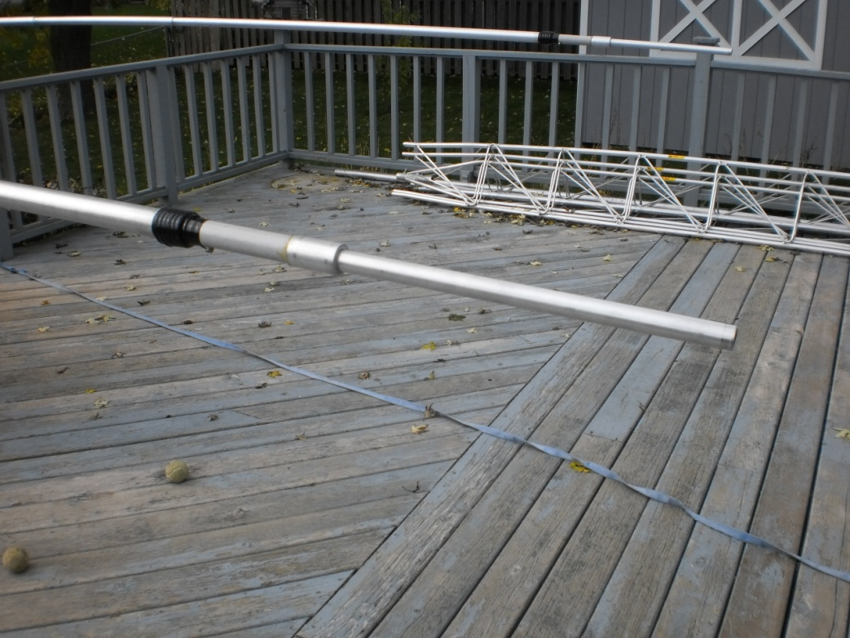
The Making of 12/17 Meter Elements
Fiberglass
Homebrew 12M
Coaxial Trap
17M element

Slide 14
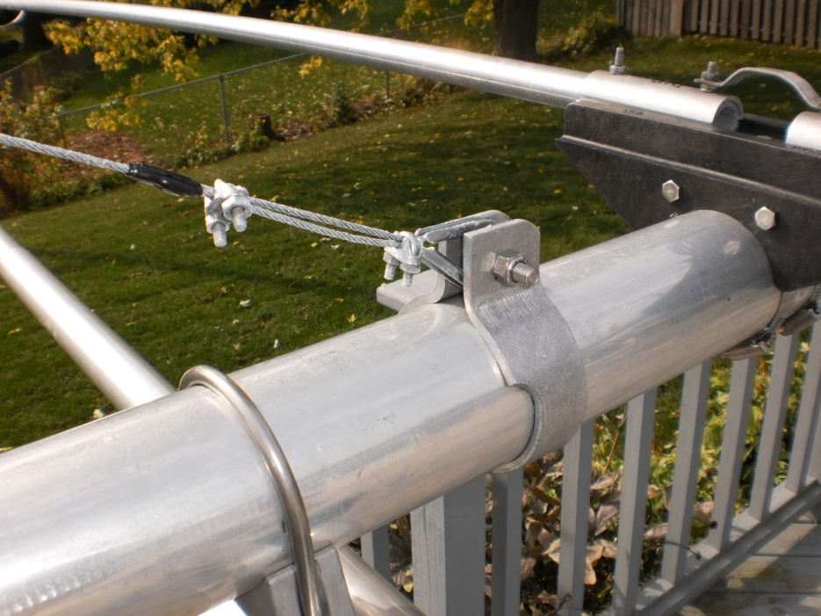
12/17 Elements, Truss and Thrust Bearing
Bead Chokes
Thrust Bearing

Slide 15
Ready to go back up!!!

Slide 16
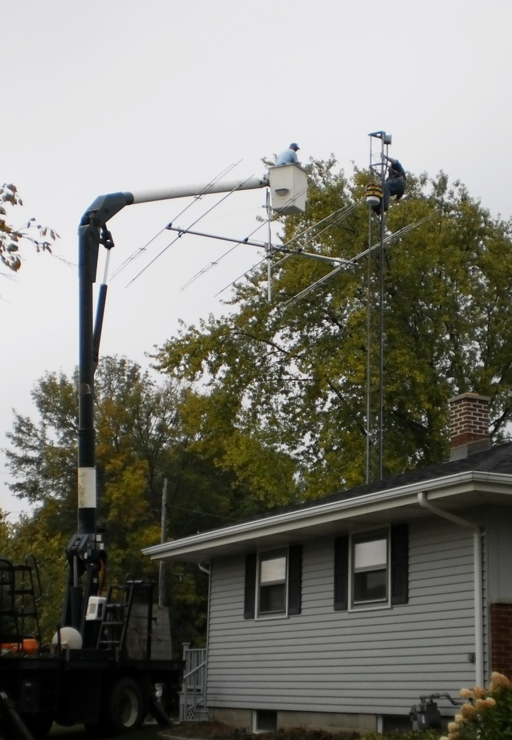
Raising it back up!!!

Slide 17
Fastening the Thrust Bearing

Slide 18
Adding the Low-Bands

Slide 19
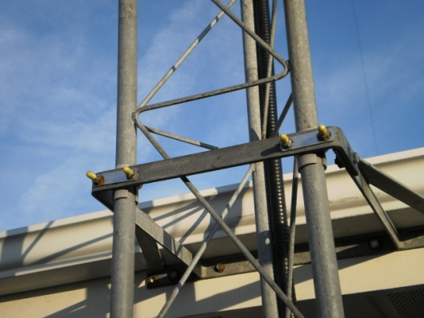
What it Actually Looks Like!
40M Half-Sloper
160M Leg
80M Inverted-L
160M Gamma
Match
Insulating Tower from Aluminum Siding
30M Half-Sloper

Slide 20
Radial System Layout

Slide 21
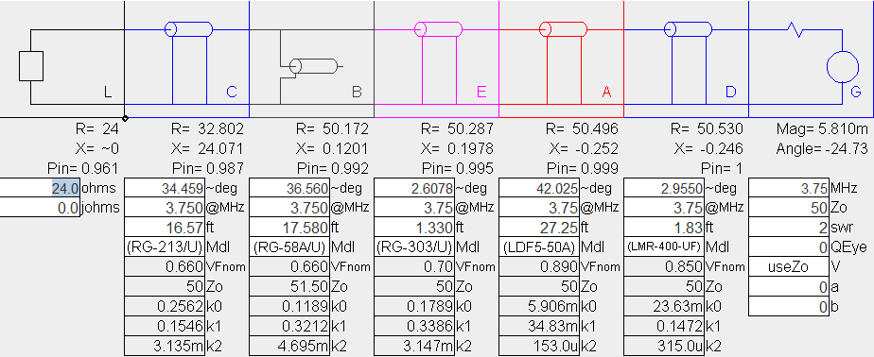
Matching the 80M Inverted-L

Slide 22
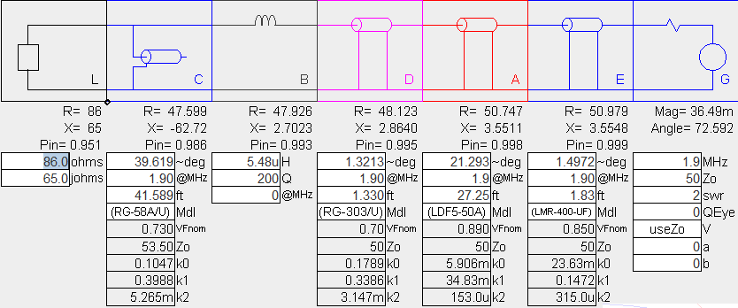
Matching the 160M Gamma
Gamma and Length still need tweaking!

Slide 23
SWR without a tuner…

Slide 24
SWR without a tuner…

Slide 25
End Result
Total Transmission line loss (Including loss due to SWR)
= .014 db @160M to .249 db @10M
Antenna Tuner no longer required
Instant Band Switching (Almost…)
If I can hear em, I can work em!!!

Slide 26
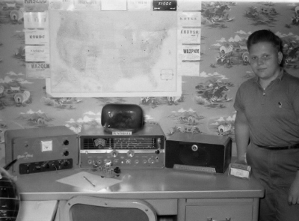
Thank you…
You are welcome to ask questions on the ORC Forum,
or eMail me at k9djt@sbcglobal.net
Dit Dit

